Slide 1


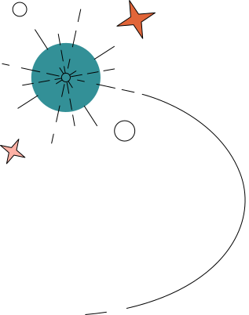
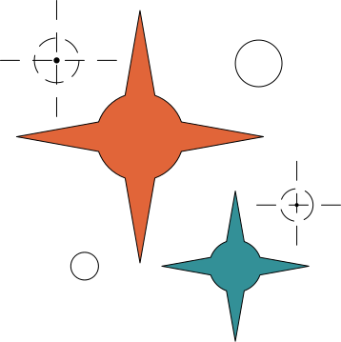





SMART CITY WEATHER SIMULATION

Slide 2



Course Code : CSE411
Course Title : Computer Graphics
Yamina Islam
Lecturer
Department of CSE
Daffodil International University

Slide 3

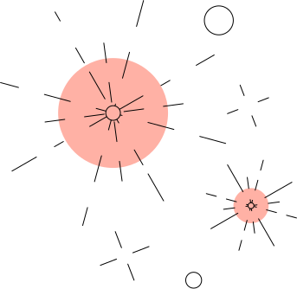

TEAM INFO
Md. Wazid Hasan Likhon
0242310005101218
Shahriar Imtiaz Limon
0242310005101283
Mosabbir Hossen Maruf
0242310005101182

Slide 4





TABLE OF CONTENT
Introduction
Objective
Methodology
Project Output
Benefits
Future Plan
Conclusion

Slide 5



INTRODUCTION
This project represents a 2D Smart City Weather Simulation developed using OpenGL and GLUT. It visually demonstrates a dynamic city environment including buildings, vehicles, weather effects, and day-night transitions. The simulation integrates multiple graphical elements such as moving cars, clouds, birds, and rain to create a realistic animated environment. User interaction is also supported through keyboard inputs to toggle weather and time conditions.

Slide 6

OBJECTIVE
To design and develop a realistic 2D city simulation.
To apply basic computer graphics concepts.
To demonstrate animation, rendering, and environmental effects.
To provide user interaction for controlling weather and day/night modes.

Slide 7


METHODOLOGY
Design scene layout (sky, road, buildings)
Draw objects using OpenGL shapes
Implement animation using timer function
Add movement (cars, clouds, birds)
Apply weather effects (rain, day/night)
Enable user control (keyboard input)

Slide 8
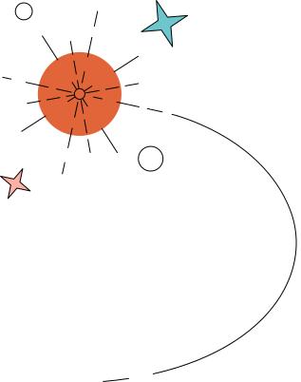
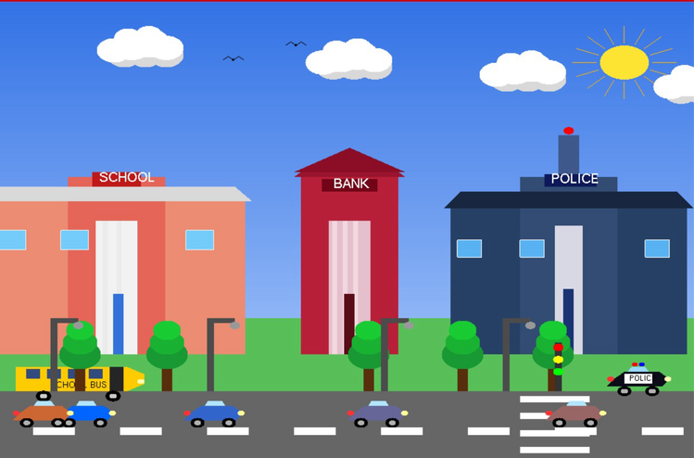
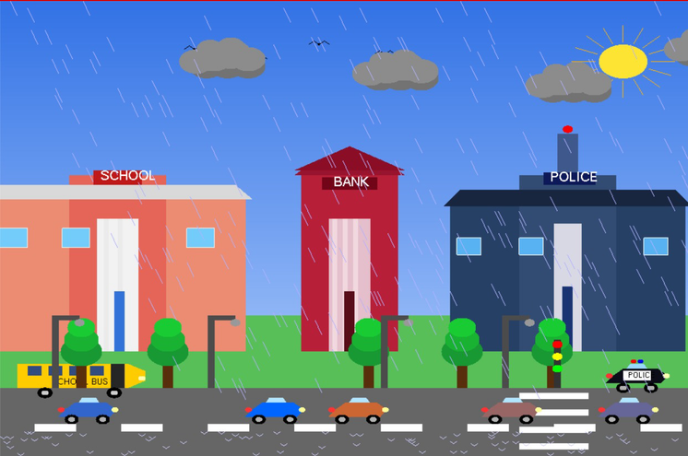
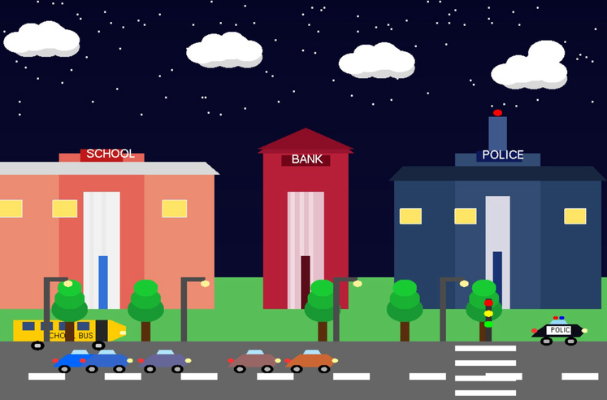
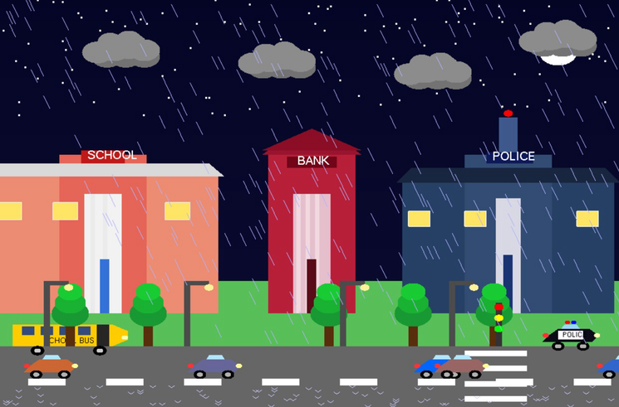
PROJECT OUTPUT

Slide 9

Enhances understanding of computer graphics concepts.
Improves animation and rendering skills.
BENEFITS
Develops problem-solving and programming ability.

Slide 10
Add more realistic features like advanced animation and smooth transitions
Extend the project to 3D simulation using advanced graphics
FUTURE PLAN
Improve visual quality with better lighting and effects

Slide 11

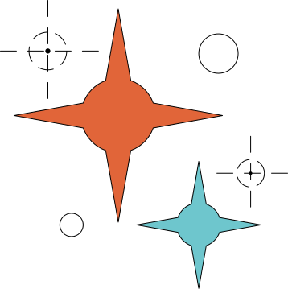
CONCLUSION
In conclusion, the Smart City Weather Simulation successfully demonstrates the use of computer graphics to create an interactive and dynamic environment. The project combines animation, user interaction, and environmental effects to simulate a real-world city scenario effectively.

Slide 12



THANK YOU !

